Slide 1

Church Financial Recordkeeping
Presented by
Divya Shree,
Ramesh Mannava,
Majesh Reddy,
Clive Matiku.

Slide 2
CONTENTS
Introduction/Problem Description
Project Plan
Process model
Team organization
Team Structure
GUI & System Design
Project Status

Slide 3
PROBLEM DESCRIPTION
Main user- church secretary (Ms. Wuthrich)
Need for a system to keep track of various donations to church
Replace the existing system, with features to support the needs of secretary- better GUI
Our project is to maintain records of donation made to a Church.
Keep track of various donations to church
Generate reports- weekly, monthly, yearly

Slide 4
PROBLEM DESCRIPTION CONTD…
Lack of shortcuts- click instead of enter
System to support editing of member details
Report customization an issue

Slide 5
PROJECT PLAN
Proper planning is done for successful completion of the project being development.
Scheduling is done, resources and time period is assigned to each task.
Each team member assigned role to play and responsibility
Plan outlines the different areas of the project.- resources, communication etc.
Includes risk management

Slide 6
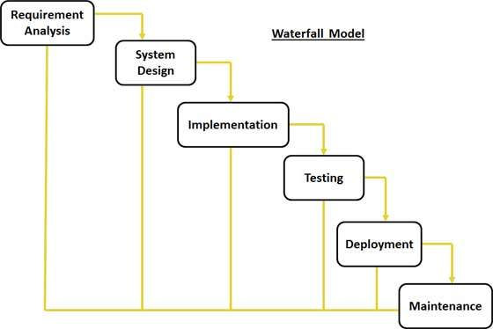
PROCESS MODEL
Water fall model:
It is simple and easy to understand and use.
Small project-no uncertain requirements

Slide 7
TEAM ORGANIZATION
The team is utilizing a controlled decentralized structure.
Team chose Ramesh as team leader
The team leader assigns tasks to members of the team.
Each will perform the tasks assigned to them to. Chip in to do other tasks if need be
Team meetings - Tuesday and Thursday to give status of assigned task and /or raise any issues

Slide 8
TEAM STRUCTURE
Ramesh Mannava- Team leader/ Lead Programmer
Clive Matiku- Project Documentation
Divya Shree- Interface Design & Reports
Majesh Reddy- Database
Note-Team members not restricted to mentioned roles only.
Can perform other duties as well if need be.

Slide 9
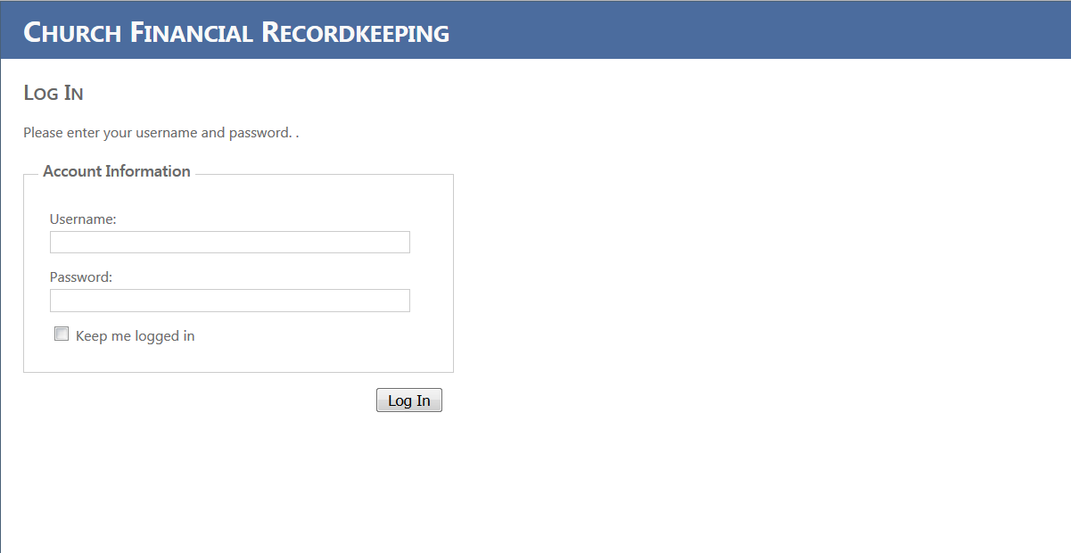
USER INTERFACE & SYSTEM DESIGN

Slide 10
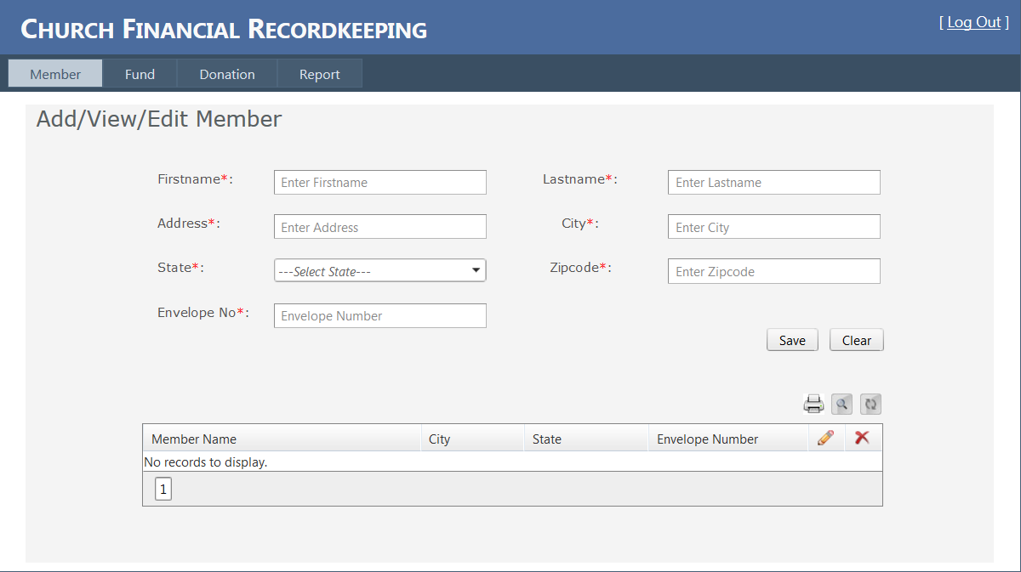
GUI & DESIGN CONTD….

Slide 11
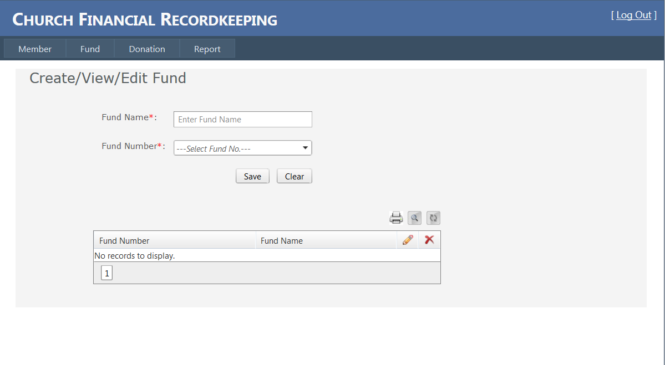

Slide 12
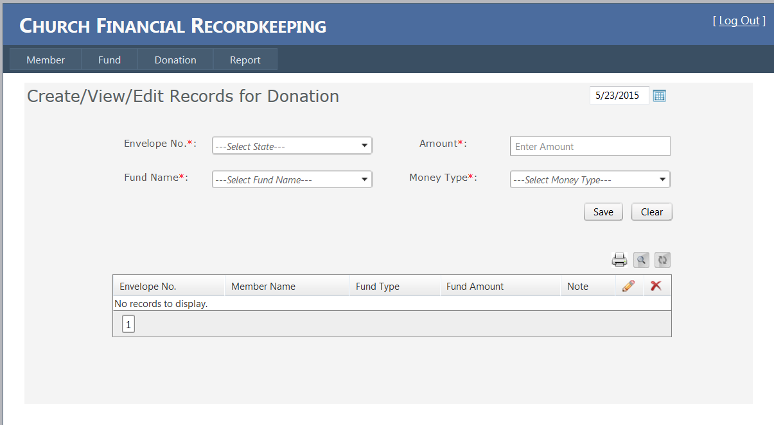
GUI & DESIGN CONTD….

Slide 13
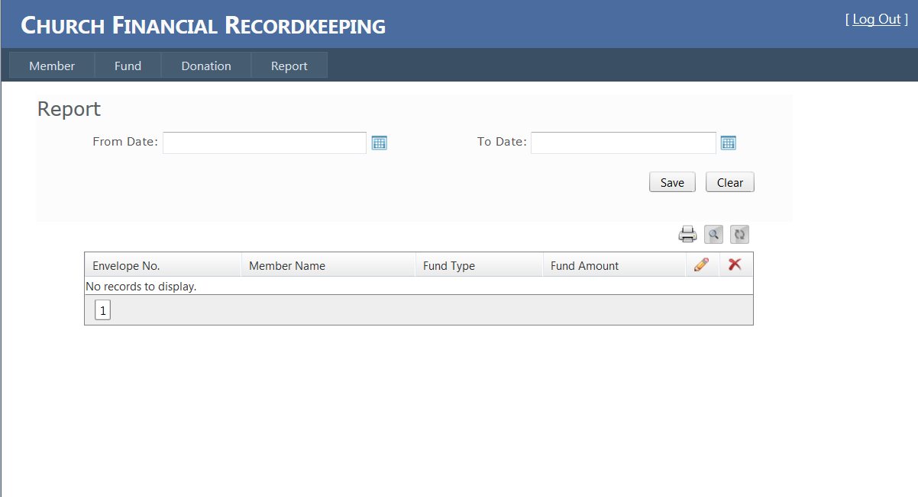
GUI & DESIGN CONTD….

Slide 14
STATUS OF PROJECT
Successful completion of requirement analysis phase
GUI done –Few modifications.
Reports underway
User coding and database underway
Coming soon –Testing and user manual

Slide 15
CONCLUSION
Project a good learning experience- importance of team work and communication
Team members making sure to follow the timeline and complete their tasks despite their busy schedules.
Regular meetings important. Keeps everyone on the same page - good for the project.

